Slide 1
Introduction to Docker
Basics of building Docker images, sharing them using image registries, orchestrating systems with Docker, and much more.
PRESENTED BY:
Sergey Tantsyura
Maxim Nakhod
Date: October 17, 2019

Slide 2
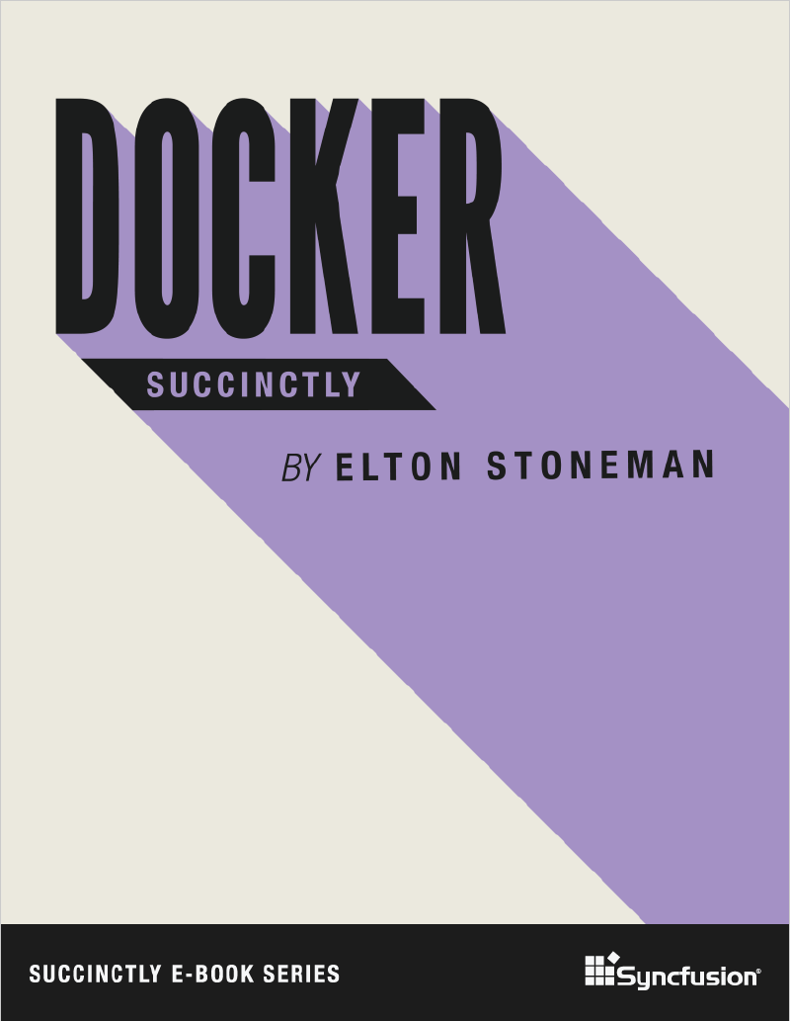
Disclaimer
Content of this training is based on Docker Succinctly e-book.
Succinctly e-book series is a great way to quickly get familiar with new technologies. These e-books are free and most of them are between 50 and 100 pages.

Slide 3
Presentation and examples on GitHub
This presentation and all examples can be found on GitHub:
https://github.com/tantsyurasergey/DockerTraining

Slide 4
Agenda
01
02
03
04
05
06
Introducing Docker
Creating Docker images
Image registries and Docker Hub
Data Storage in Docker
Orchestrating Systems with Docker
Clustering Hosts with Docker Swarm
Notes:
01, 03, 05, 07 (??????????????????????) – STA
02, 04, 06 – MN
Samples:
01
run SQL server Linux container
Run some windows container
02
create ASP.NET Core app and package it into container
Multi-stage build, first stage builds from sources, second stage packages output of first stage
03 – push created image to image registry, show script
MN to provide link to registry + set access rights
04
add logging, show how to mount folder where logs will be written to.
??? – use folder for DB files in SQL server
05
Start SQL + web app simultaneously, pass connection string to sql server via env variable
+ update web app to use data from DB
06
Run apps from 05 in Docker Swarm
07
??????????????????????????????????????? Kubernetes

Slide 5
Introducing Docker

Slide 6
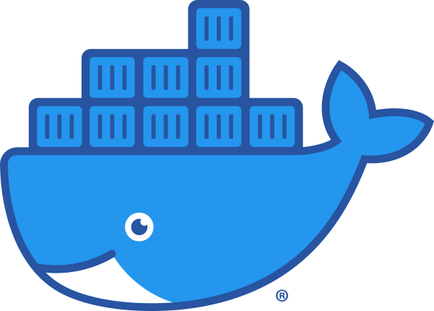
What is Docker?
Docker is an application platform. It lets you package your application with everything it needs, from the operating system upwards, into a single unit that you can share and run on any computer that has Docker. Docker runs your application in a lightweight, isolated component called a container.

Slide 7
Advantages of Docker
The application package, called a Docker image, is typically only tens or hundreds of megabytes, so it’s cheap to store and fast to move.
When you run a container from the image, it will start in seconds and the application process actually runs on the host, which means you can run hundreds of containers on a single machine.
Images can be versioned, so you can be sure the software you release to production is exactly what you’ve tested.
With Docker, you can build your application image and know that it will run in the same way on your development laptop, on a VM in an on-premise test lab, or on a cluster of machines in the cloud.

Slide 8
Advantages of Docker
Docker is open source and cross-platform, and one of its ecosystem’s most compelling aspects is the Docker Hub—a public registry where organizations and individuals share their own application container images.
In Docker, the packaging process is where development and operations meet, which means it’s a great start for the transition to DevOps. And having a framework for orchestrating work between many containers gives you the foundation for microservice architectures.

Slide 9
Installing Docker
Docker is a single product which has three components:
Background server that does the work;
Docker client, a command-line interface for working with the server;
REST API for client-server communication.
The client is cross-platform, which means you can run it natively from Linux, Windows, and OS/X machines, and you can manage Docker running locally or on a remote machine.
The Docker server runs on Linux and on the latest versions of Windows.

Slide 10
Installing Docker
The Docker team has put together packages for Mac and Windows that make use of virtualization technology on the host so that your Docker server runs inside a Linux VM on your OS/X or Windows machine (you run the client locally and talk to the server through the REST API exposed on the VM).
On Windows, you’ll need to have Hardware Virtualization (VT-x) enabled in the BIOS to run the Docker Linux VM, and after installing you’ll need to reboot.
You can switch between Windows containers and Linux containers.

Slide 11
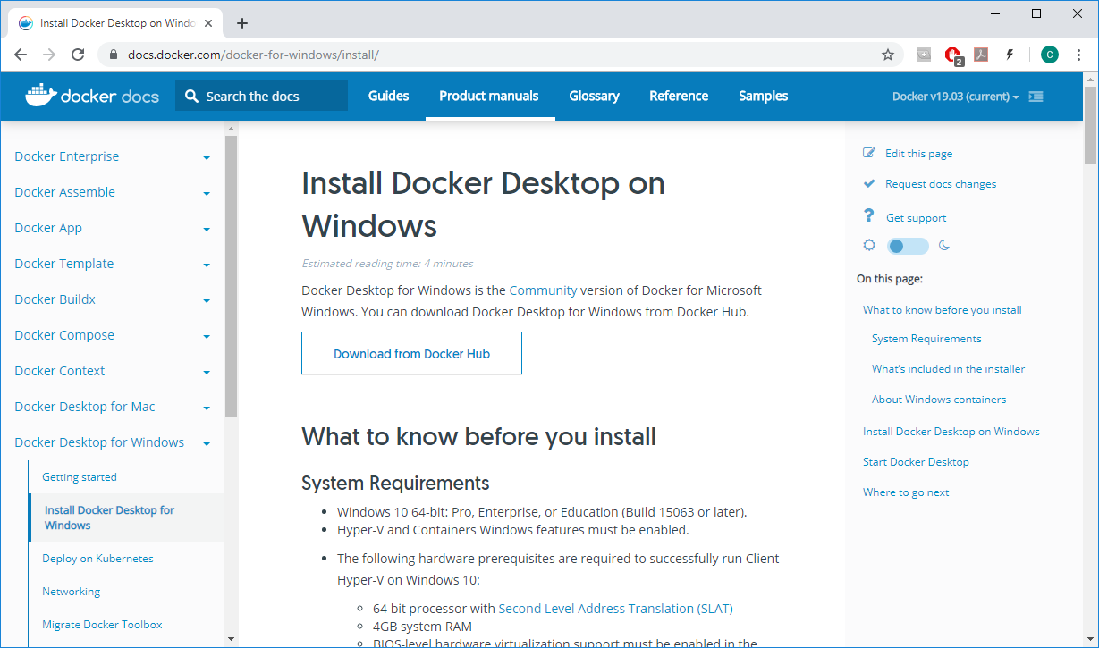
Installing Docker

Slide 12
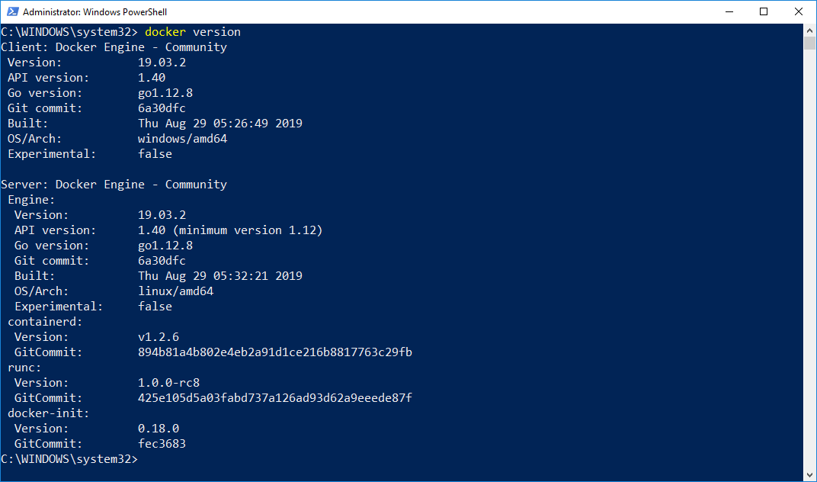
Installing Docker
After Docker Desktop is installed, try running docker version command

Slide 13
Running containers
Docker images are packaged applications. You can push them to a central store (called a registry) and pull them on any machine that has access to the registry. The image is a single logical unit that contains the application package. In order to start the app, you run a container from the image.
Images are typically built to run a single process. If your app needs to work with other services, you run those services in their own containers and orchestrate them so that all the containers can work together.
When you run a container from an image, it may be a short-lived app that runs some functionality and then ends; it may be a long-running app that runs like a background service; or it may be an interactive container that you can connect with as though it was a remote machine.

Slide 14
Running containers
Run a command in a new container:
docker container run [OPTIONS] IMAGE [COMMAND] [ARG...]
Frequently used options:
Option | Description
-d, --detach | Run container in background and print container ID
-e, --env list | Set environment variables
-i, --interactive | Keep STDIN open even if not attached
--name string | Assign a name to the container
-p, --publish list | Publish a container's port(s) to the host

Slide 15
Managing containers
Manage containers:
docker container COMMAND
Frequently used commands:
Command | Description
exec | Run a command in a running container
ls | List containers
rm | Remove one or more containers
run | Run a command in a new container
stop | Stop one or more running containers

Slide 16
Running containers
DEMO
Notes:
Sample commands can be found in src/01_Introducing_Docker
When connecting to SQL Server using SQL Server Management Studio, specify “localhost,14330” as server name
Show switching from Linux containers to Windows containers, show output of “docker version” command after switching.
Mention requirement to install updates to be able to run Windows containers. Show output of “docker version” command, it includes system architecture.

Slide 17
Creating Docker images

Slide 18
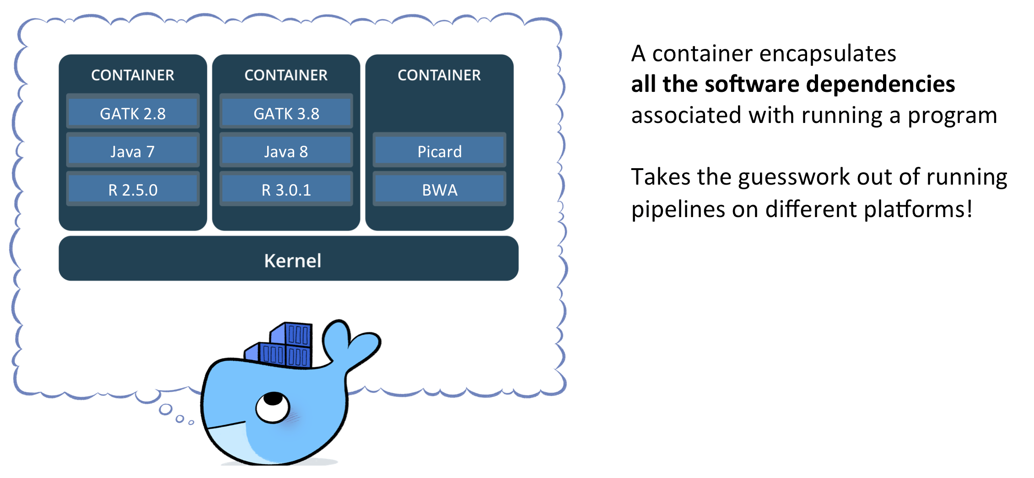
The world base is not enough
Containers must work right after start, so images must contain all required software and settings and do not require any configuration afterwards.

Slide 19
Welcome dockerfile
FROM ubuntu
RUN apt-get update && apt-get install nano
Notes:
Dockerfile can be named anyhow, but dockerfile is a standard name

Slide 20
Build process
Build process is executed by the docker service/daemon.
Build context and docker file are sent to service to create an image.

Slide 21
Build process. Layers
Each command in a docker file creates a new “temp” image. So resulting image is a set of layers.
All temp images are cached and used when possible.
ENTRYPOINT command
FROM mcr.microsoft.com/dotnet/core/aspnet:3.0
COPY bin/Debug/netcoreapp3.0/*.* ./
ENV ASPNETCORE_URLS=http://+:5000
EXPOSE 5000
ENTRYPOINT ["dotnet", "SampleWebApp.dll"]
EXPOSE command
ENV command
COPY command
Base image

Slide 22
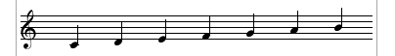
Commands you can use
There are just 12 commands you can use.
Not so many but …
there are only 7 notes used to create all music ☺
https://docs.docker.com/develop/develop-images/dockerfile_best-practices

Slide 23
Commands you can use
Defines base image for the image.
The only mandatory command.
Notes:
Use official images where possible.
Use version tags to avoid latest hell.
FROM

Slide 24
Commands you can use
Runs a command in the build context.
Notes:
Each run command creates a new layer – better to compose several in 1 line.
Cache is used, so you may have weird behavior.
RUN

Slide 25
Commands you can use
Copy files from build context to the image.
Notes:
Wildcards can be used.
Only files from build context are available, but not the whole FS.
COPY

Slide 26
Commands you can use
Sets default execution command for the container.
Notes:
Should be only 1 in a dockerfile.
Might be omitted in certain cases.
CMD

Slide 27
Creating docker images
DEMO
Notes:
Demo scripts are in 02_Creating_Docker_Images folder
Creating and running image for SampleWebApp
Creating image in several stages
Creating Ubuntu with built-in utils

Slide 28
Image registries and Docker Hub

Slide 29
About image registries
Packaging an application into a container image is easy with the docker image build command, but the image only gets created in the local image cache on your own machine.
In order to make that image useful, you need to be able to ship it to different hosts, and that’s where image registries come in.
A registry is simply a shared location for images—you can push images you’ve created and pull images that you or other people have created.
The registry is a core concept in Docker, and you use the normal Docker command-line tool to work with registries.

Slide 30
About Docker Hub
The Docker Hub is a free, public registry for images maintained by Docker, Inc.
It is a hugely popular service— there is more than a million of images on the Hub.
Anyone can push images to the Hub, and in addition to the community images, there are also official images curated by Docker and supported by their owners.
Docker Hub is the default source and has a very useful feature set that makes it much more than just an image store. However, if you’re not comfortable storing your own application images in a third-party cloud service, there are many other options.

Slide 31
Using Docker Hub
You will need your own account on Docker Hub if you want to push images and share them.
You can register with Docker Hub at https://hub.docker.com and create a free account.
The username you choose will be the user part of the repository name when you build your own images (my username on Docker Hub is tantsyurasergey, and I can only push images which are prefixed tantsyurasergey).
Docker Hub can be used for storing private repositories, too, and the free plan lets you store one private repository and unlimited public ones.

Slide 32
Pushing images
When you have an account registered with the Docker Hub, you will need to add your credentials to the Docker CLI using the following command:
docker login
After logging in, you will be able to push images as well as pull them. The image push command is very simple:
docker image push [OPTIONS] NAME[:TAG]
The push works intelligently, pushing only layers that aren’t already available in the registry. Only the new layers created by building my Dockerfile get pushed.

Slide 33
Pulling images
Image size can be a few megabytes or many gigabytes, so pulling large images might take a while, which means startup time for a new container can jump from seconds to minutes.
In order to prevent that, you can explicitly pull images from the Hub and download them before they are needed, so that when you do run a container it uses the local image:
docker image pull [OPTIONS] NAME[:TAG|@DIGEST]

Slide 34
Tags and image versions
Docker image repositories use the basic format {user}/{app}, but often the tag is used to specify a release version, or a variant of the image, in the format {user}/{app}:{tag}.
If you don’t specify a tag when you refer to an image, the default latest tag is used.
One image can have multiple tags. Tags can be version numbers, commit labels, codenames—any useful way to classify images.
It’s important to specify a tag for base images in your FROM instruction. If you don’t, the image tagged as latest will be used. That tag can change to a different image without warning, and there can be breaking changes between image versions, which means your own images might fail to build.

Slide 35
Choose your base image carefully
Docker Hub is the default registry, and there are thousands of high-quality images available there, but only the official repositories are curated. There are no quality gates on any other images in the Hub, which means anyone can build anything into an image.
The official repositories are the best place to start. Not only are they actively supported, but the Docker Hub scans the images against a security vulnerability database and will flag any issues it finds.
If your base image is not from an official repository, the publisher is not required to keep that image up-to-date or even available. If you build from another user’s base image on the Hub, that repository can be deleted, leaving you unable to build your own image. If that’s a concern, you should consider cloning the source and building your own image.

Slide 36
Running your own registry
For commercial or sensitive applications, you might not want your images built and hosted on a public service, even in a private repository. In that case, you can run your own registry on your own hardware with Docker’s registry image:
docker container run -d -p 8080:5000 registry:2
The registry address is a part of the full image tag, so in order to push an existing image from your cache to your registry, you will need to tag it with the address:
docker image tag tantsyurasergey/samplewebapp:1.0.0 localhost:8080/tantsyurasergey/samplewebapp:1.0.0
Once image is tagged properly, it can be pushed to local registry:
docker image push localhost:8080/tantsyurasergey/samplewebapp:1.0.0

Slide 37
Working with image registries
DEMO
Notes:
Sample commands can be found in src/03_Image_registries_and_Docker_Hub
Use this URL to show that local registry is running and repository is created:
http://localhost:8080/v2/_catalog
Sitecore registry:
http://nuget1ca2/feeds/SC_Dev_Containers

Slide 38
Data Storage in Docker

Slide 39
Docker follows 12 factor app principles
«The twelve-factor app never assumes that anything cached in memory or on disk will be available on a future request or job»
https://12factor.net/processes

Slide 40
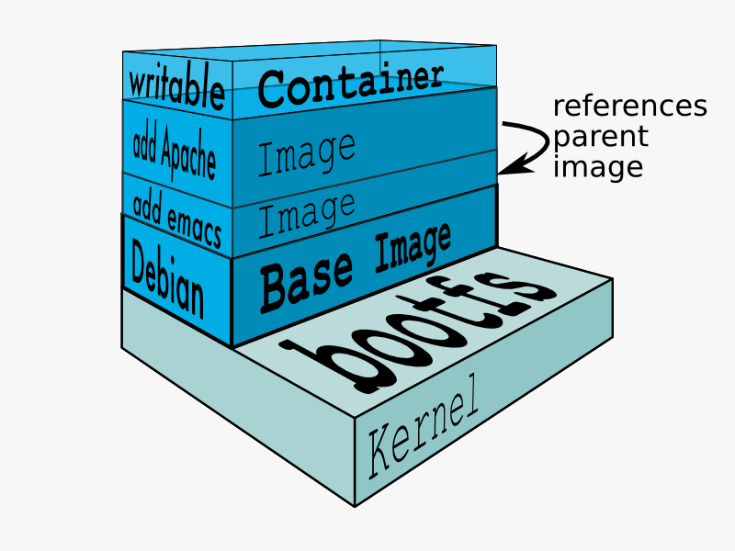
Layered File System
Each container has its own RW layer in file system, but base images FSs are RO.
As a result, each container starts exactly in the same state as other containers started from the same image.

Slide 41
Stateless containers
DEMO
Notes:
Sample commands can be found in src/04_Data_Storage
Demo SQL server without volumes – restart erases all databases

Slide 42
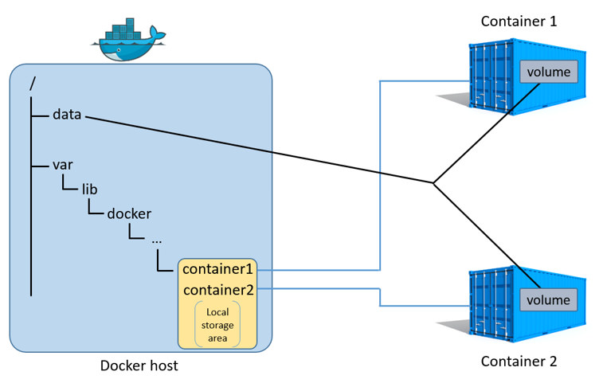
Rules are there to break them
If you want to persist data or share data between containers use VOLUMEs
docker run … -v mssql:/var/opt/mssql mcr.microsoft.com/mssql/server:2019-CTP3.2-ubuntu

Slide 43
Logs sharing
DEMO
Notes:
Sample commands can be found in src/04_Data_Storage
Demo SQL server with volume attached
Demo app with logs in folder
Demo SQL server with folder attached

Slide 44
Summarize data sharing
You may share:
Data volumes (DBs, indexes)
Folders (folder to write logs to)
Files (e.g. license)

Slide 45
Orchestrating Systems with Docker

Slide 46
Orchestrating multicontainer solutions
When you break down a large application into smaller parts with each part running in a separate container, you’ll need a way for containers to work together. That’s called orchestration.
Orchestration requires a framework that allows communication between containers, configuration of how containers need to be connected, scheduling for container creation, monitoring of health, and scaling.
There are external platforms for container orchestration—Mesos and Kubernetes are popular—but Docker has orchestration built into the platform.

Slide 47
About Docker networks
Docker is the platform for your application runtime, and it controls how your container interacts with resources from the host. You can set memory and CPU restrictions on containers, and when your app runs it only sees the resources allocated to it. At the network level, Docker creates a bridge network on your host.
A bridge network gives every container its own IP address, and it allows communication between containers and also between containers and the host.
There are other types of networks supported by Docker. The bridge network is for working with containers on a single host. The overlay network is for working with containers that run across multiple hosts.

Slide 48
Creating and using Docker networks
Creating a network in Docker is easy. Bridge networks are the default, which means you simply need to give the network a name:
docker network create docker_training_network
Once network is created, we can start container that joins the new network:
docker container run -d --name docker_training_nginx --network docker_training_network nginx:alpine
The --network option tells Docker to join container into the network, which means container will get an IP address from the network’s range.

Slide 49
Inspecting Docker networks
We can get the IP address either by inspecting the container or the network:
docker network inspect docker_training_network
Because network is a bridge network, it should be possible to access container by its IP address from the host.
Note: The bridge is between the container and the host. If you’re running on Linux you can access containers by their IP address. On Docker for Mac and Docker for Windows, remember the host is a Linux VM, so you can’t connect directly to the container IP address from your host machine.

Slide 50
Docker DNS Server
Docker has a built-in DNS server, so containers on the same network can access each other by name as well as by IP address.
The DNS server in Docker makes application configuration easy in a multicontainer system because, in your applications, you simply refer to dependencies by their container name. If you have a database container called mysql, the connection string in your web app can always use mysql as the server name. You don’t need to switch connection strings for different environments—provided you orchestrate the same way in every environment.
When you make assumptions about server names in your system, orchestration becomes a key part of your delivery. You can use Docker Compose to ensure containers get orchestrated correctly.

Slide 51
Using Docker networks
DEMO
Notes:
Sample commands can be found in src/05_Orchestrating_Systems_with_Docker/NetworkManagement

Slide 52
About Docker Compose
Docker Compose is a separate client tool that lets you define your solution architecture in a YAML file, and then manage a whole set of containers with a single command.
Docker Compose comes bundled with Docker for Mac, Docker for Windows, and the Docker Toolbox. On Linux, it’s a separate install.
The Docker Compose syntax takes the arguments available in the docker container run command and structures them as YAML. You specify an image to run from, container names, ports to expose, volumes to map, and networks—all the major command-line options are supported by Compose.

Slide 53
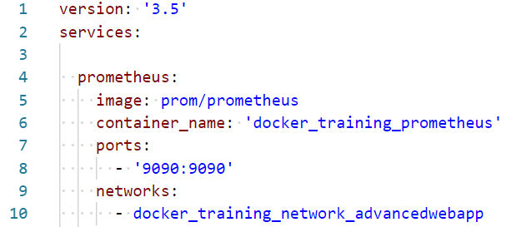
Docker Compose file
In Compose, you define containers to run as services, then you specify the image name and any other optional properties, such as the container name, ports and networks in this example:

Slide 54
Starting containers using Docker Compose
By convention, Compose files are named docker-compose.yml. From the directory where the YAML file is saved, you can start all the services in the Compose file as containers by running the up command:
docker-compose up -d
As with the Docker CLI, we can specify -d to daemonize all the containers and keep them running in the background.
Containers started using Docker Compose are just normal Docker containers and we can work with them using Docker CLI in the normal way.

Slide 55
Scaling using Docker Compose
Docker Compose lets you scale up by adding more containers. More containers can be added with the scale option to the up command as in the following example, which specifies the desired number of containers:
docker-compose up –d --scale [SERVICE_NAME]=5
The DNS server in Docker supports load balancing, which means that if you repeat web requests to the scaled service, each request may be routed to a different container instance.
Notes:
In docker-compose.yml it is possible to use deploy.replicas to set scaling level.

Slide 56
Administer all the containers
It is possible to administer all the containers in Compose project with single commands. These are typically the Docker CLI commands transplanted to Docker Compose.
To stop all the containers:
docker-compose stop
To start all the containers:
docker-compose start
To stop and remove all the containers:
docker-compose down
When you create services with Compose, Docker has no notion that they’re related (other than being in the same network). In order to manage the services as a single unit, you work in the directory on your client machine where the docker-compose.yml file lives.

Slide 57
Benefits of using Docker Compose
With Docker Compose, you can orchestrate complex applications by linking containers together and running them inside a Docker network. Distributed solutions can be captured at the infrastructure level in a Compose file.
Each component in the stack refers to its dependencies by name, and that will be consistent for every environment in which the containers are in the same network, even if they are running at different levels of scale (which means there’s no change to application configuration).

Slide 58
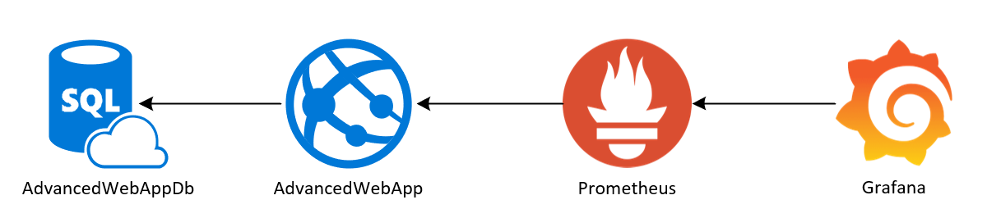
Using Docker Compose
DEMO
Notes:
Sample web app can be found in src/05_Orchestrating_Systems_with_Docker/AdvancedWebApp
Sample commands can be found in src/05_Orchestrating_Systems_with_Docker/AdvancedWebApp_Orchestration

Slide 59
Clustering Hosts with Docker Swarm

Slide 60
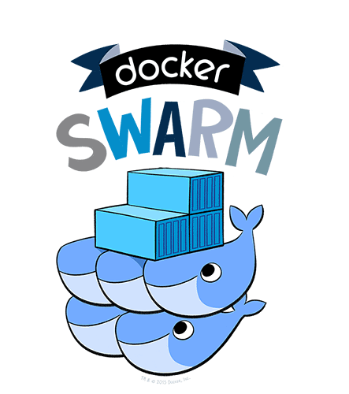
Docker Swarm
Adjust power with 1 command

Slide 61
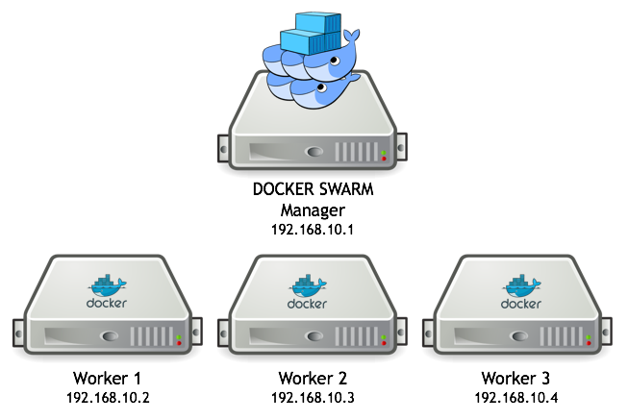
Setting up a cluster
docker swarm init
docker swarm join …
That’s it ☺

Slide 62
Mixed swarm environment
You may have nodes on Windows, Linux and even ARM

Slide 63
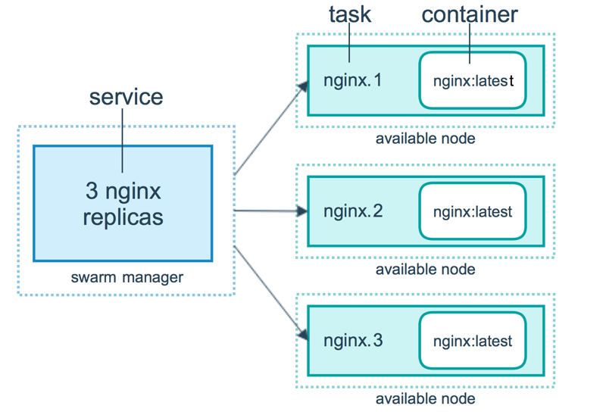
Service is almost a container but better
Service is an abstraction over container that can be scaled
docker service create --name web --publish 80:80 nginx:alpine
docker service scale web=5
docker service ps web

Slide 64
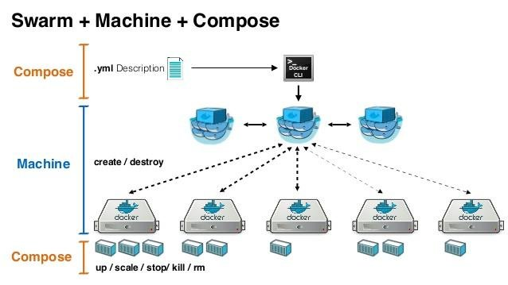
A cherry on top
Docker swarm + docker compose

Slide 65
Using Docker Swarm
DEMO
Notes:
Initialize 3 ubuntu VMs
Init swarm on 1 of them
Join swarm from another
Create service nginx:alpine
Show its availability on both nodes
Add node
Show that nginx available on newly added node
Scale service

Slide 66
Notes
Use the latest available docker when playing with swarm.
Consider using docker-machine tool to create “dockernized” VMs.

Slide 67
Q&A

